Slide 1
Single Layer Percetron
Prof. G. Panda
Professorial Fellow
IIT Bhubaneswar

Slide 2


Architecture
We consider the architecture: feed-forward NN with one layer
It is sufficient to study single layer perceptrons with just one neuron:
Single Layer Perceptron
2
Notes:
10-00
2

Slide 3
Perceptron: Neuron Model
Uses a non-linear (McCulloch-Pitts) model of neuron:
b (bias)
x₁
w₁
v
y
x₂
w₂
ϕ(v)
w_{m}
x_{m}
ϕ is the sign function:
+1 IF v >= 0
ϕ(v) =
Is the function sign(v)
-1 IF v < 0
Single Layer Perceptron
3

Slide 4
Perceptron: Applications
The perceptron is used for classification: classify correctly a set of examples into one of the two classes C₁, C₂:
If the output of the perceptron is +1 then the input is assigned to class C₁
If the output is -1 then the input is assigned to C₂
Single Layer Perceptron
4

Slide 5
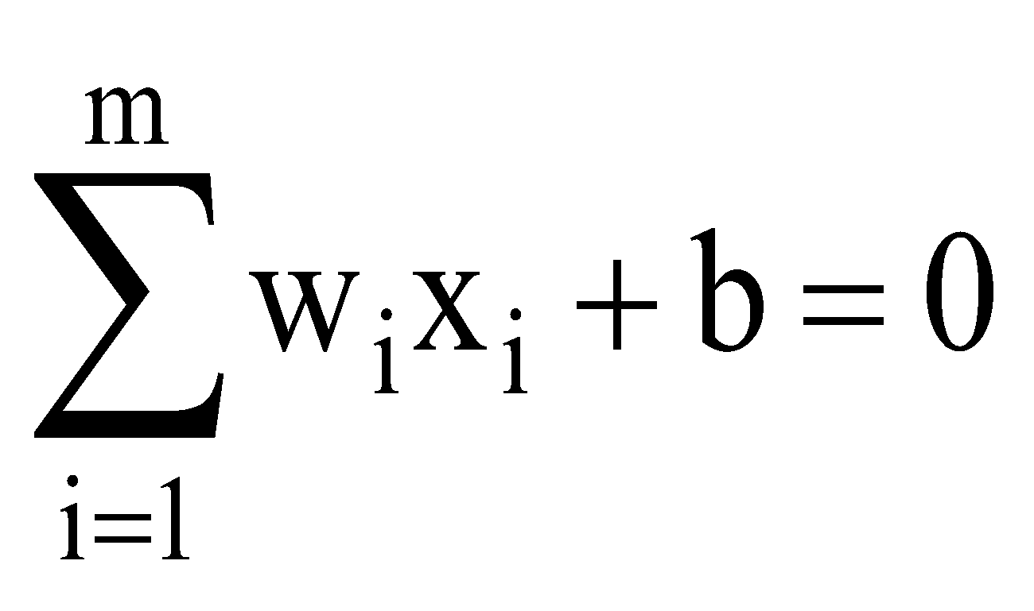
Perceptron: Classification
The equation below describes a hyperplane in the input space. This hyperplane is used to separate the two classes C1 and C2
decision
region for C1
x₂
w₁x₁ + w₂x₂ + b > 0
decision
boundary
C₁
decision
region for C₂
x₁
C₂
w₁x₁ + w₂x₂ + b <= 0
w₁x₁ + w₂x₂ + b = 0
Single Layer Perceptron
5

Slide 6
Perceptron: Limitations
The perceptron can only model linearly separable functions.
The perceptron can be used to model the following Boolean functions:
AND
OR
COMPLEMENT
But it cannot model the XOR. Why?
Single Layer Perceptron
6

Slide 7
Perceptron: Limitations
The XOR is not linear separable
It is impossible to separate the classes C₁ and C₂ with only one line
C₁
x₂
C₂
1
1
-1
C₁
0
-1
1
0
1
x₁
Single Layer Perceptron
7

Slide 8
Perceptron: Learning Algorithm
Variables and parameters
x(n) = input vector
= [+1, x₁(n), x₂(n), …, x_{m}(n)]^{T}
w(n) = weight vector
= [b(n), w₁(n), w₂(n), …, w_{m}(n)]^{T}
b(n) = bias
y(n) = actual response
d(n) = desired response
η = learning rate parameter
Single Layer Perceptron
8

Slide 9
The fixed-increment learning algorithm
Initialization: set w(0) =0
Activation: activate perceptron by applying input example (vector x(n) and desired response d(n))
Compute actual response of perceptron:
y(n) = sgn[w^{T}(n)x(n)]
Adapt weight vector: if d(n) and y(n) are different then
w(n + 1) = w(n) + η[d(n)-y(n)]x(n)
+1 if x(n) ∈ C₁
Where d(n) =
-1 if x(n) ∈ C₂
Continuation: increment time step n by 1 and go to Activation step
Single Layer Perceptron
9

Slide 10
Example
Consider a training set C₁ ∪ C₂, where:
C₁ = {(1,1), (1, -1), (0, -1)} elements of class 1
C₂ = {(-1,-1), (-1,1), (0,1)} elements of class -1
Use the perceptron learning algorithm to classify these examples.
w(0) = [1, 0, 0]^{T} η = 1

Slide 11
Example
x₂
1
-
-
+
Decision boundary:
2x₁ - x₂ = 0
C₂
-1
1/2
1
x₁
-1
C₁
-
+
+
Single Layer Perceptron
11

Slide 12
Convergence of the learning algorithm
Suppose datasets C₁, C₂ are linearly separable. The perceptron convergence algorithm converges after n₀ iterations, with n₀ ≤ n_{max} on training set C₁ ∪ C₂.
Proof:
suppose x ∈ C₁ ⇒ output = 1 and x ∈ C₂ ⇒ output = -1.
For simplicity assume w(1) = 0, η = 1.
Suppose perceptron incorrectly classifies x(1) … x(n) …∈ C₁. Then w^{T}(k) x(k) ≤ 0. ⇒ Error correction rule: w(2) = w(1) + x(1) w(3) = w(2) + x(2) ⇒ w(n+1) = x(1)+ …+ x(n)
w(n+1) = w(n) + x(n).

Slide 13
Convergence theorem (proof)
Let w₀ be such that w₀^{T} x(n) > 0 ∀ x(n) ∈ C₁. w₀ exists because C₁ and C₂ are linearly separable.
Let α = min w₀^{T} x(n) | x(n) ∈ C₁.
Then w₀^{T} w(n+1) = w₀^{T} x(1) + … + w₀^{T} x(n) ≥ nα
Cauchy-Schwarz inequality: ||w₀||² ||w(n+1)||² ≥ [w₀^{T} w(n+1)]²
||w(n+1)||² ≥ (A)
n² α ²
||w₀|| ²
Single Layer Perceptron
13

Slide 14
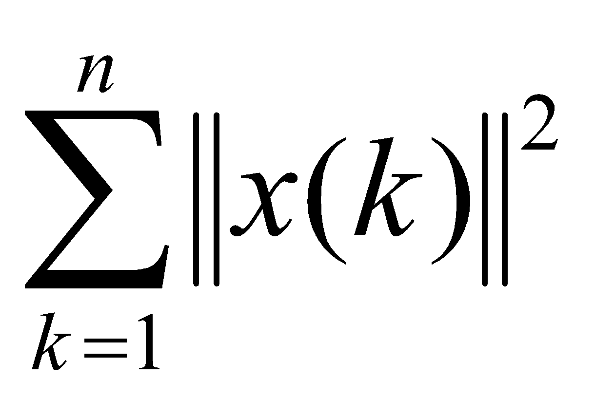
Convergence theorem (proof)
Now we consider another route: w(k+1) = w(k) + x(k) || w(k+1)||² = || w(k)||² + ||x(k)||² + 2 w ^{T}(k)x(k) euclidean norm  ≤ 0 because x(k) is misclassified
⇒ ||w(k+1)||² ≤ ||w(k)||² + ||x(k)||² k=1,..,n
=0
||w(2)||² ≤ ||w(1)||² + ||x(1)||²
||w(3)||² ≤ ||w(2)||² + ||x(2)||²
⇒ ||w(n+1)||² ≤
Single Layer Perceptron
14

Slide 15
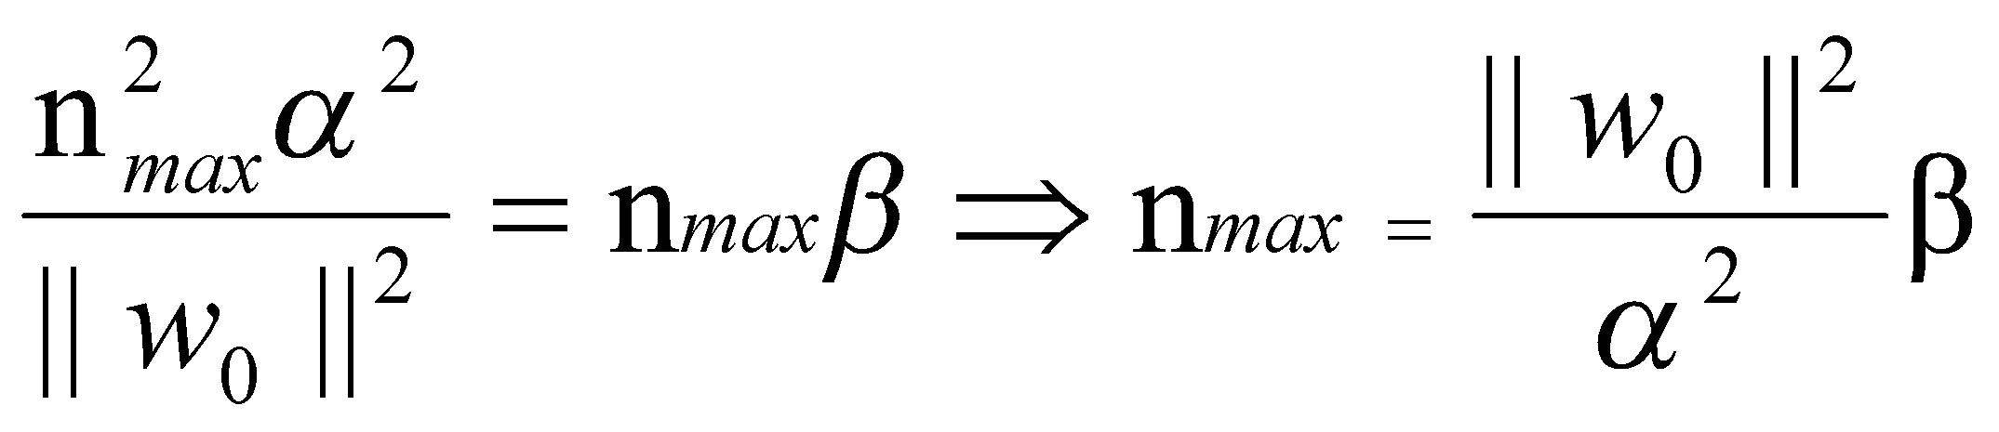
convergence theorem (proof)
Let β = max ||x(n)||² x(n) ∈ C₁
||w(n+1)||² ≤ n β (B)
For sufficiently large values of k: (B) becomes in conflict with (A). Then n cannot be greater than n_{max} such that (A) and (B) are both satisfied with the equality sign.
Perceptron convergence algorithm terminates in at most n_{max}= iterations.
β ||w₀||²
α²
Single Layer Perceptron
15

Slide 16
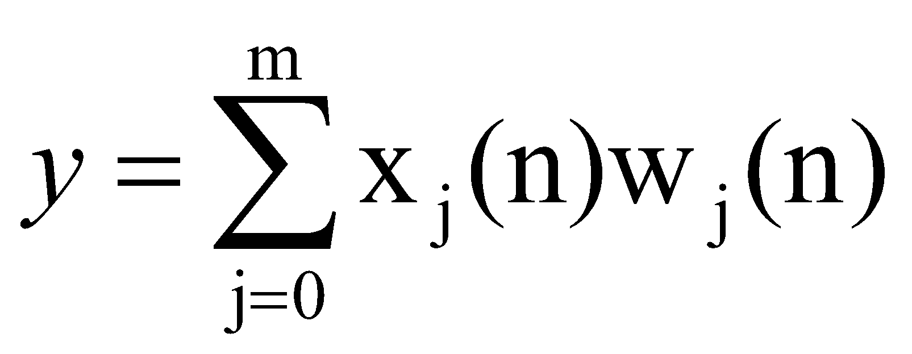
Adaline: Adaptive Linear Element
The output y is a linear combination o x
x₁
w₁
y
x₂
w₂
w_{m}
x_{m}
Single Layer Perceptron
16

Slide 17
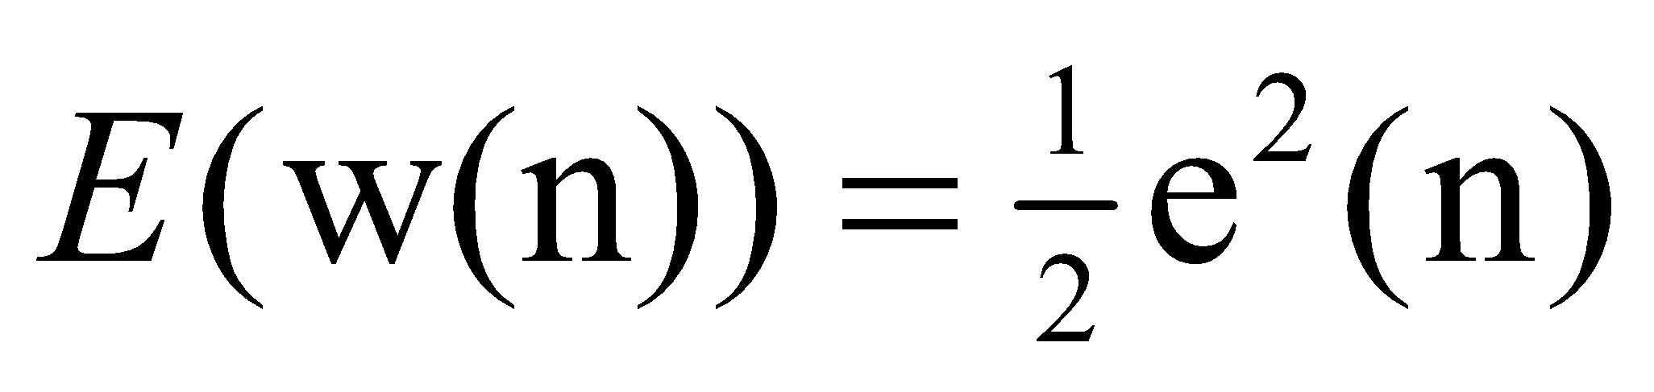
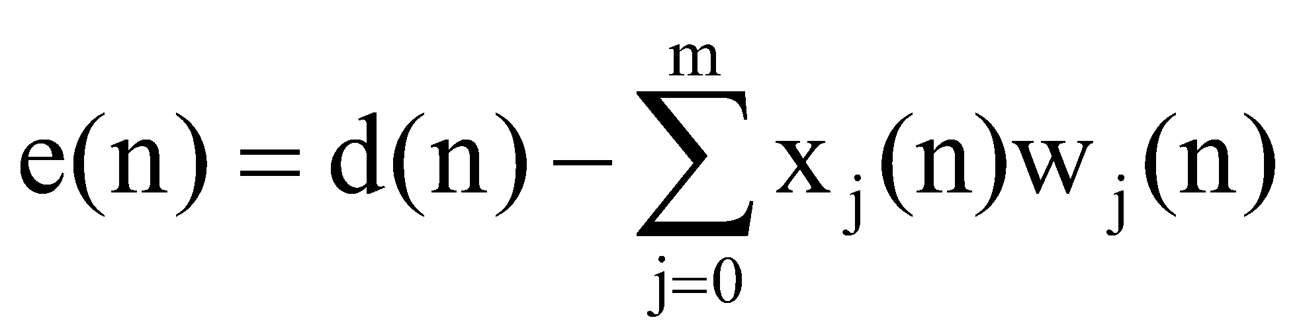
Adaline: Adaptive Linear Element
Adaline: uses a linear neuron model and the Least-Mean-Square (LMS) learning algorithm
The idea: try to minimize the square error, which is a function of the weights
We can find the minimum of the error function E by means of the Steepest descent method
Single Layer Perceptron
17

Slide 18
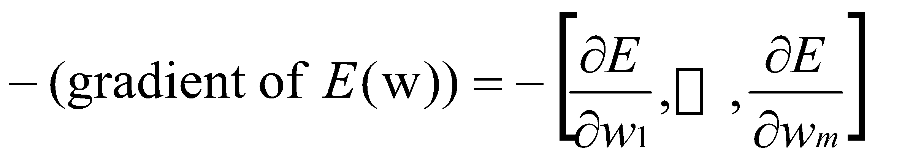
Steepest Descent Method
start with an arbitrary point
find a direction in which E is decreasing most rapidly
make a small step in that direction
Single Layer Perceptron
18

Slide 19
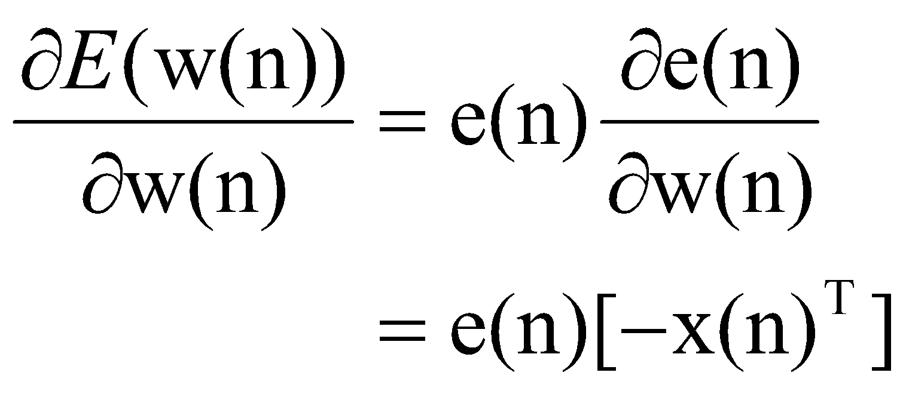

Least-Mean-Square algorithm (Widrow-Hoff algorithm)
Approximation of gradient(E)
Update rule for the weights becomes:
Single Layer Perceptron
19

Slide 20
Summary of LMS algorithm
Training sample: input signal vector x(n)
desired response d(n)
User selected parameter η >0
Initialization set ŵ(1) = 0
Computation for n = 1, 2, … compute
e(n) = d(n) - ŵ^{T}(n)x(n)
ŵ(n+1) = ŵ(n) + η x(n)e(n)
Single Layer Perceptron
20

